Slide 1


DAMG 6210 -DATA MANAGEMENT AND DATABASE DESIGN
FALL 2025
PROPERTY
MANAGEMENT SYSTEM
PROFESSOR: MANUEL MONTROND
TEAM 10:
CHIRAG PATIL - 002303363
DAMINI THORAT - 002478953
IRBAZHUSAIN SHAIKH - 003185038
SAUMYA GORANTALA - 002301659
ZILONG ZHOU - 002059809

Slide 2


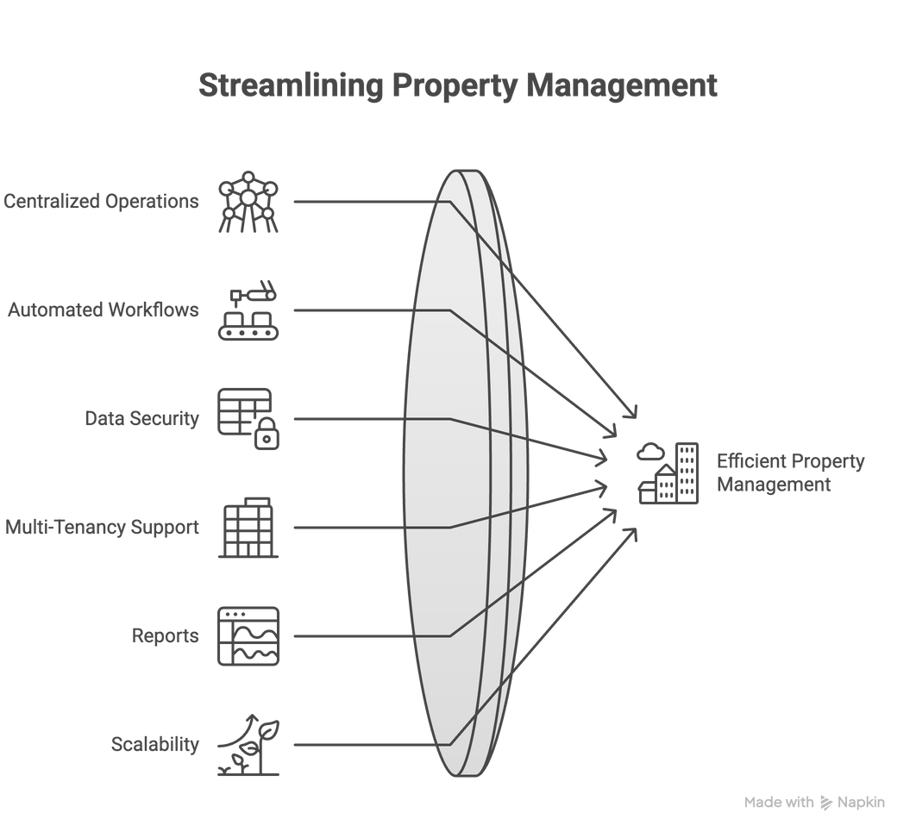
PURPOSE AND GOALS
An enterprise-grade database platform enabling property management companies to centralize operations, automate workflows, and scale efficiently with built-in security, multi-tenancy, and compliance features.

Slide 3

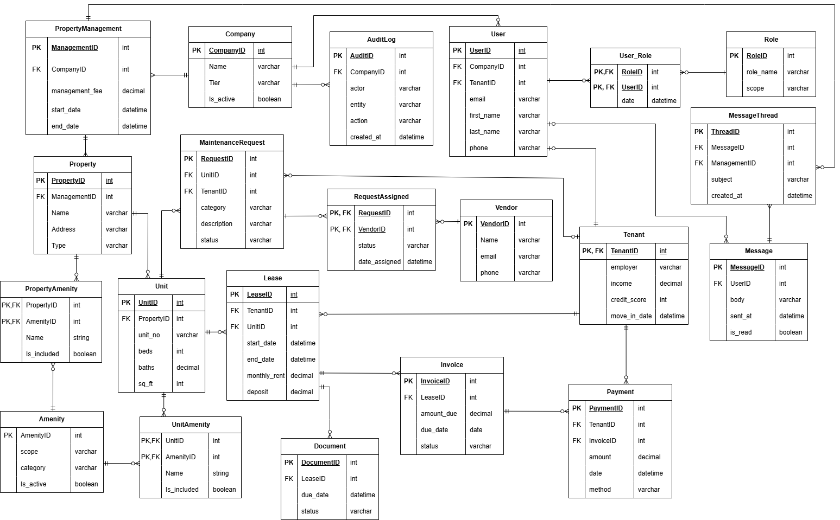
ENTITY RELATIONSHIP DIAGRAM

Slide 4

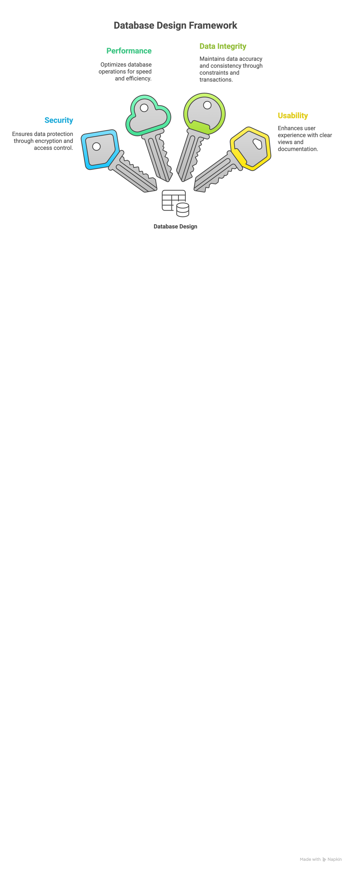

DATABASE DESIGN
z

Slide 5
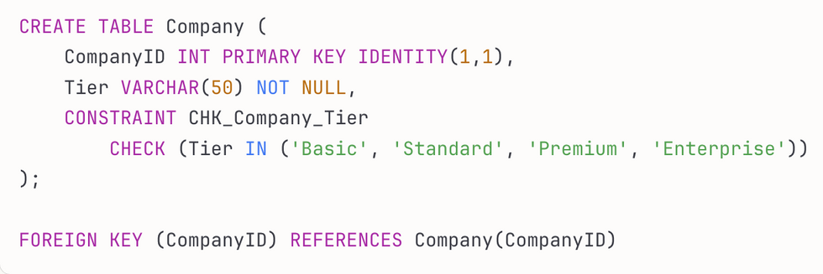
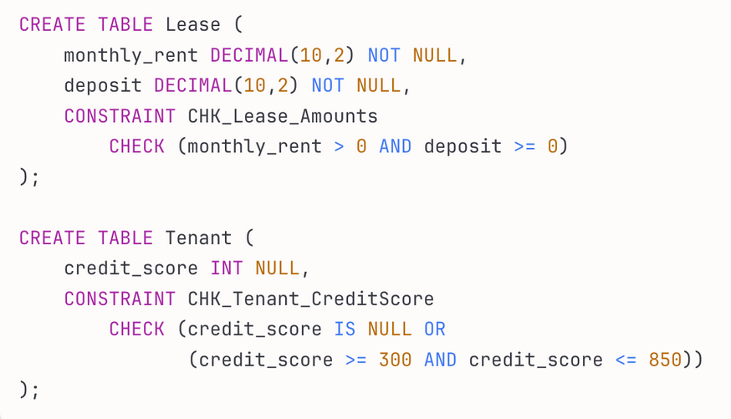
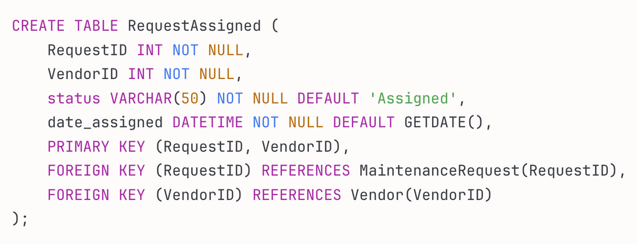
DDL
z

Slide 6

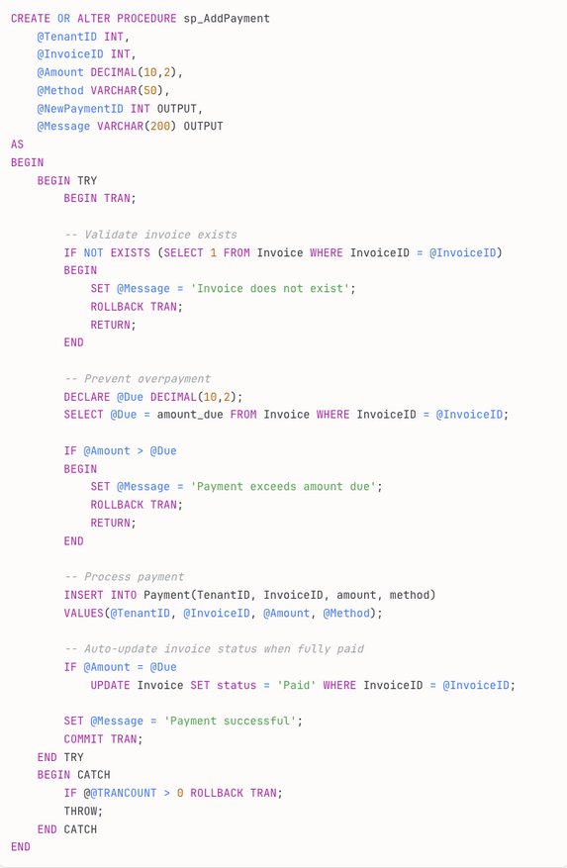
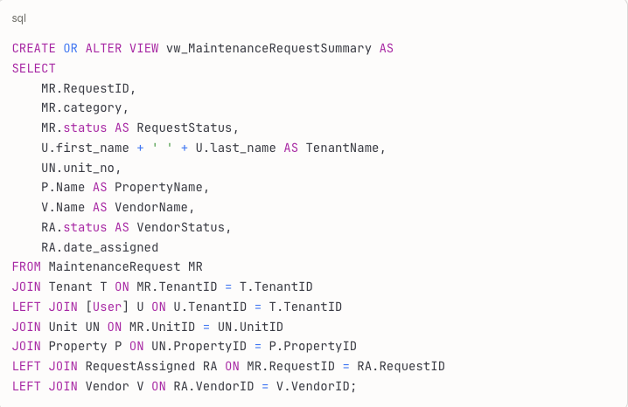
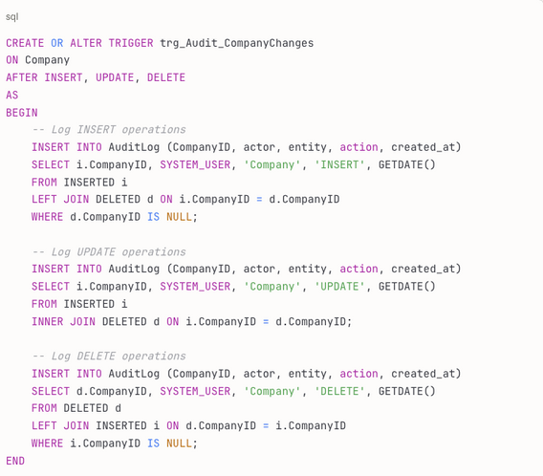
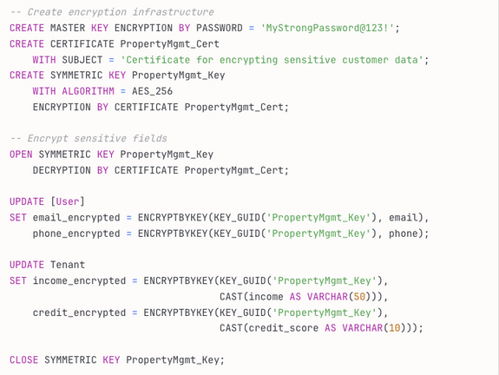
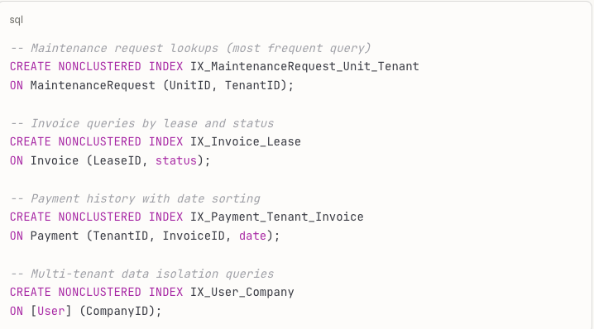
DATABASE OBJECTS
STORED PROCEDURE: SMART PAYMENT PROCESSING
VIEW: MAINTENANCE REQUEST DASHBOARD
TRIGGER: AUTOMATED AUDIT LOGGING
ENCRYPTION: PROTECTING SENSITIVE DATA (AES-256)
PERFORMANCE OPTIMIZATION: STRATEGIC INDEXING

Slide 7
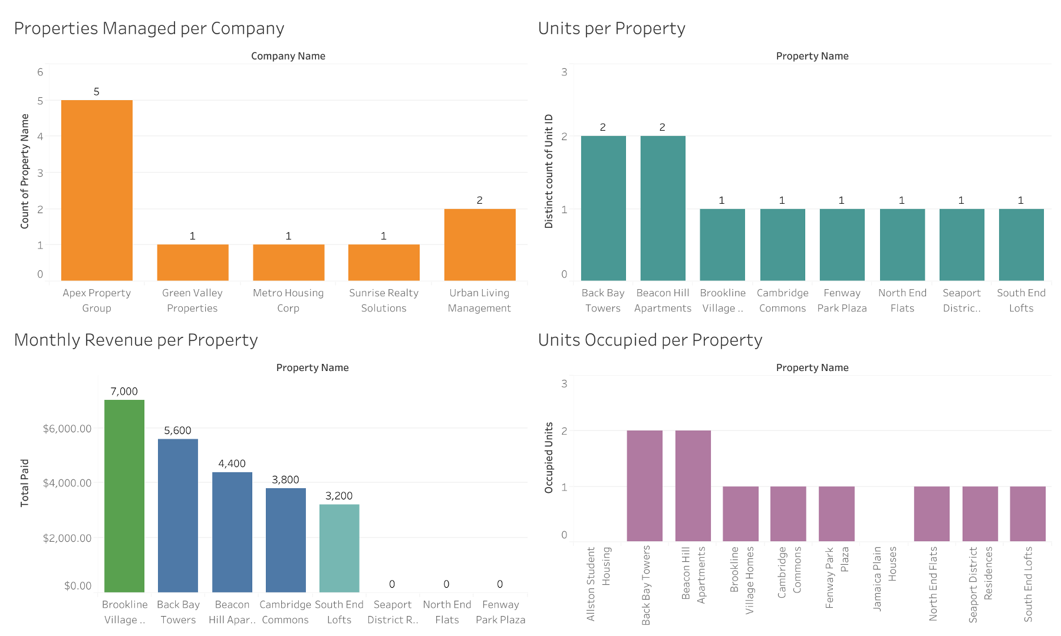
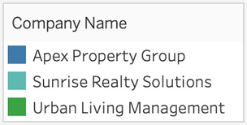
PROPERTY & FINANCIAL ANALYTICS DASHBOARD

Slide 8
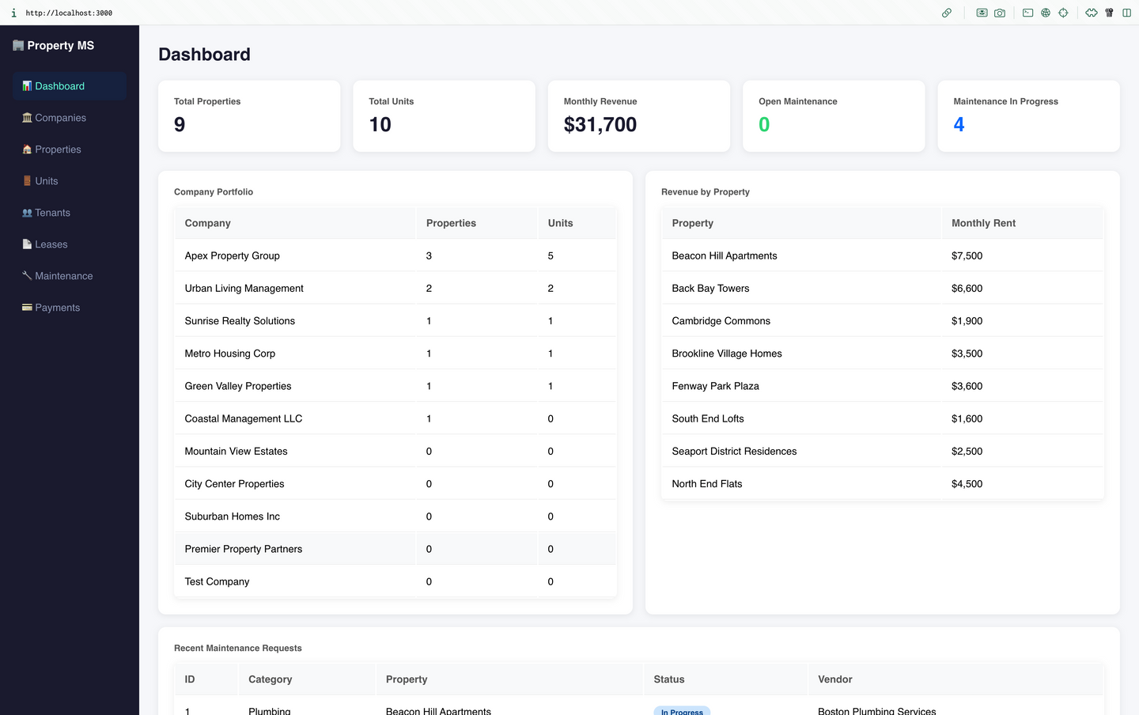
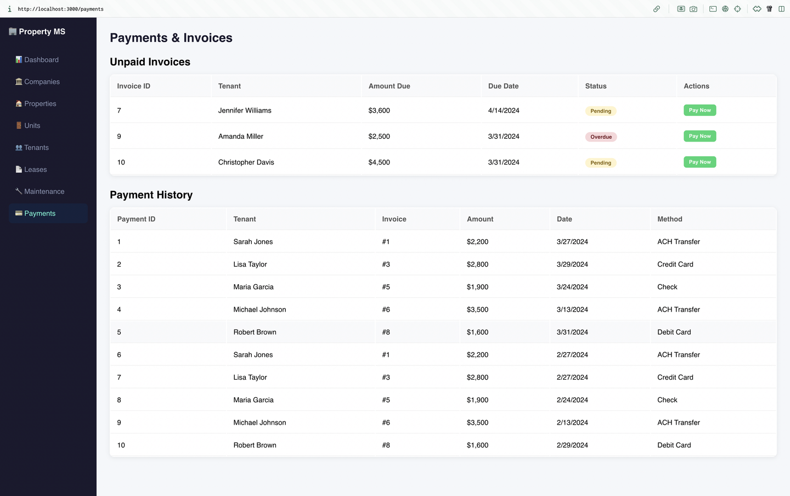
GUI SCREENSHOTS

